Slide 1
Thermal Averages in Monte Carlo
Yuan Ping
Slides Credits to Dane Morgan

Slide 2
Outline
Reading:
Leach, Molecular Modeling, ’01, Ch. 8.1-8.6
Allen and Tildesley, Computer Simulation of Liquids, ’89, Ch. 4.1-4.4
How to take a thermal average with the Metropolis sampling algorithm
Equilibration
Errors in averages

Slide 3
How Do We Get Something from MC
Analysis tools
Trajectories: Atom paths, collisions, atomic changes
Thermodynamic averages
Simple averages: Basic thermodynamic quantities
Fluctuations: Susceptibilities (fluctuation-dissipation theorem)
Spatial correlation functions: Structure
Time correlations: Transport coefficients (fluctuation-dissipation theorem)

Slide 4
Obtaining Thermal Averages From MC Very similar to MD
The MC algorithm will converge to sample states with probability ρ(s) = probability expected from statistical mechanics. So a thermal average is given by
Note that N_{mcs} should be taken after the system equilibrates
Fluctuations are also just thermal averages and calculated the same way

Slide 5
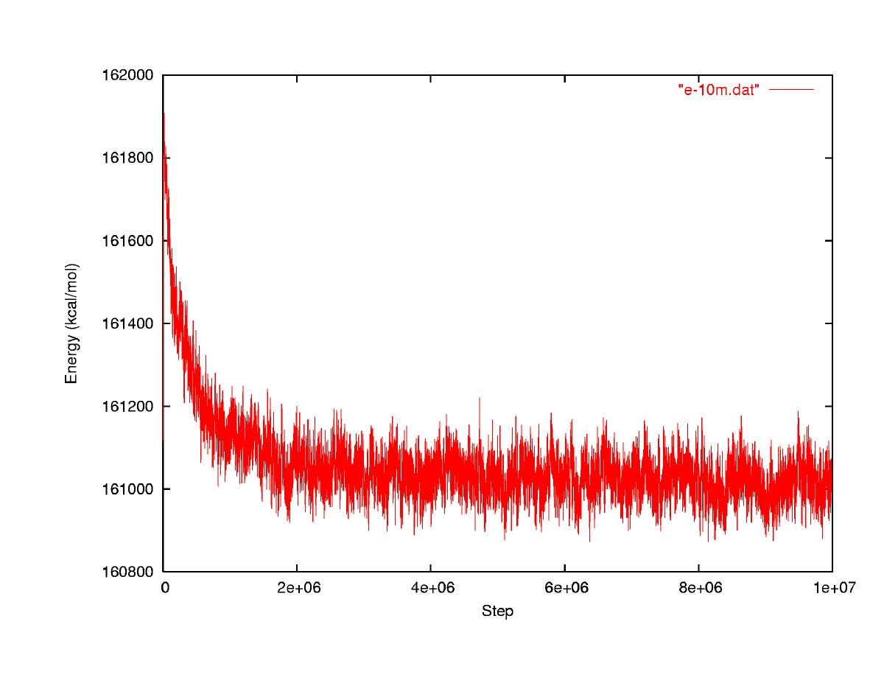
Thermal Average in MC
Equilibration period: Not equilibrated, thermal averages may be wrong
Converged: Equilibrated, thermal averages will be right
Energy
√<(δE)²>
<E>
MC Step
http://mccammon.ucsd.edu/~dzhang/research/ccmv/

Slide 6
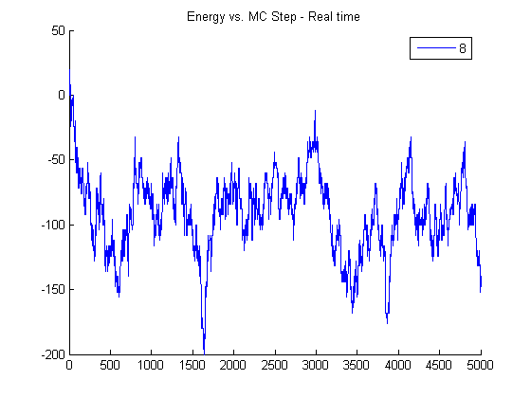
Energy Vs. MC Step
Equilibration period: Not equilibrated, thermal averages may be wrong
Equilibrated, thermal averages will be right
Energy
√<(dE)²>
Correlation length?
<E>
Correlation length: a measurement of the distance at which the pair correlation function decays to 1
MC Step

Slide 7
Measuring Errors of Averages Same as MD
What is the statistical error in <A>_{L} vs. L?
For uncorrelated data
For correlated data
See previous slides for how to get these values.

Slide 8
Summary
MC averages look different because sampling is biased
You must equilibrate MC to get only equilibrium state space exploration before averaging
Errors in means are like MD and must be corrected for correlation

